Slide 1
DATAMITES - INTERNSHIP
PROJECT ID: PRDA-0 SUPPLY CHAIN ANALYSIS
PROJECT TEAM ID: PTID-CDA-OCT-25-814
Project By: JONNALAGADLA BADRINATH
MEKALA UDAY KIRAN REDDY
BOIRI MUSKAN
SRAVANI BHAVANASI

Slide 2
Project Objective
Conduct an end-to-end diagnostic of SKU performance across the supply chain.
Evaluate demand flow, inventory health, production alignment, supplier dependability, and logistics spend.
Highlight operational bottlenecks impacting revenue, availability, and cost.
Provide strategic insights enabling optimized reorder cycles, supplier tiering, and logistics cost reduction.

Slide 3
DATASET OVERVIEW
A structured end-to-end supply chain dataset enabling performance analytics across products, suppliers, logistics, quality, and inventory.
Dataset composition
100+ skus across cosmetics, skincare, and haircare.
Multi-supplier sourcing network with varied lead times.
Complete supply chain attributes from production → delivery.
Key data fields
Product data: SKU, product type, price, availability.
Demand data: units sold, order quantity.

Slide 4
production & operations: production volume, processing time, lead time.
inventory metrics: stock levels, manufacturing cost.
supplier metrics: supplier ID, distance, lead time, reliability.
quality control: inspection results, defect rate (%).
logistics: transport mode, route, delivery time, shipping cost.
Purpose of the dataset
To evaluate revenue flow, inventory balance, supplier performance, quality stability, and logistics cost efficiency—supporting data-driven operational strategy.

Slide 5
KEY KPIs
Total Revenue: $2.29m
Products Sold: 46K units
Avg. Price: 49.46
Avg. Lead time: 15.96 days
Key insight: strong performance in skincare + top skus driving most sale.

Slide 6
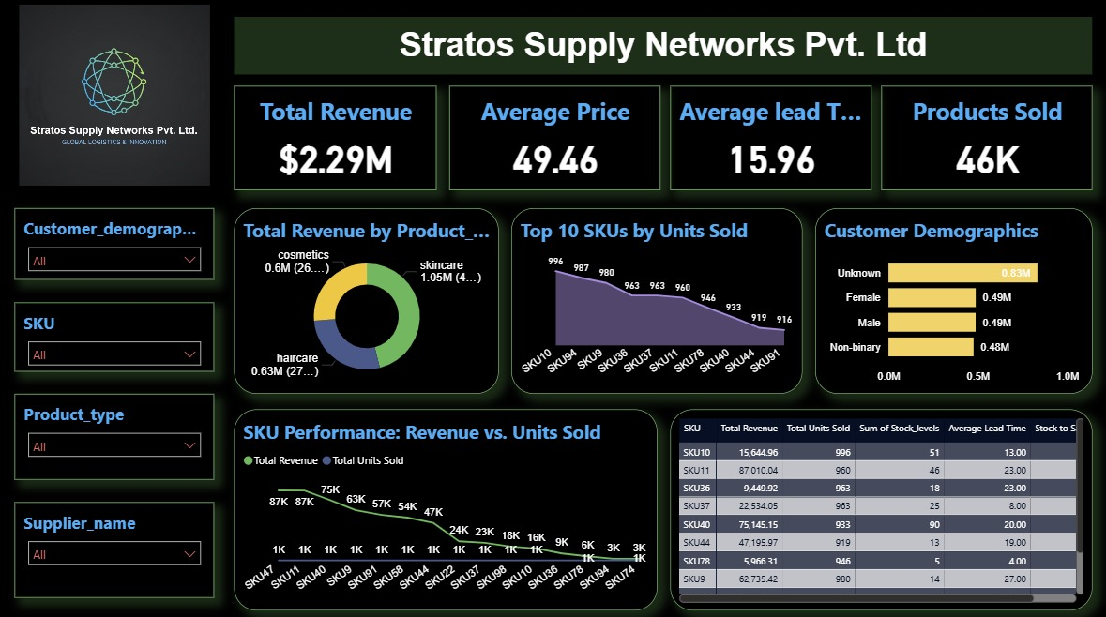
Dashboard Overview

Slide 7
Total Revenue Breakdown
Chart: donut chart (from dashboard)
Highlights:
Skincare: $1.05M (47%)
Haircare: $0.63M (27%)
Cosmetics: $0.61M (26%)
Summary: skincare is the highest-revenue category, contributing nearly half of total sales.

Slide 8
PRODUCT MIX & CATEGORY INSIGHTS
skincare → highest demand + highest price point
haircare → stable middle performer
cosmetics → lower revenue but competitive volume
opportunity: expand skincare variants & bundle slower-moving cosmetic skus

Slide 9
Top 10 SKUs by Units Sold Chart:
Line chart (top 10 units sold)
Key skus: SKU10, SKU04, SKU36, SKU37, SKU03
Insight:
  sku10 leads with 996 units sold
  top 5 skus account for >40% of total volume
  suggests dependence on a few high-performing skus

Slide 10
SKU Performance: Revenue vs Units
Chart: Revenue vs Units comparison
Insights:
  some skus show high unit sales but low revenue → low price point
  some skus show high revenue with lower units → premium products
  recommending price optimization and targeted promotions

Slide 11
Inventory & Lead Time Analysis
Based on table:
Average lead time: 15.96 days
Skus with highest stock levels show slower movement
SKU11 has the highest revenue but also a longer lead time (23 days), potential supply chain bottleneck
Recommendation: supplier re-evaluation & reorder point adjustment

Slide 12
Customer Demographics
Customer segments:
  Unknown: 0.83M
  Female: 0.49M
  Male: 0.49M
  Non-binary: 0.48M
key insight: high proportion of “unknown” customer data — requires cleansing for better marketing strategy.

Slide 13
Supplier-Wise Insights
Filter-based analysis (from dashboard dataset)
Identify suppliers causing long lead times
Top suppliers contributing to revenue
Recommendation: strengthen relationships with consistent suppliers to reduce average lead time

Slide 14
Key Findings
Skincare drives nearly half of revenue
Top 10 skus dominate overall sales
Customer demographic data incomplete — opportunity for data enhancement
Lead time averages ~16 days → room to optimize supply chain speed
Inventory management improvement needed for slow-moving skus

Slide 15
Recommendations
Optimize supply chain lead time
  Reduce delays from high-lead-time suppliers
Strengthen high-performing skus
  Increase stock for SKU10, SKU04, SKU36
Improve customer data capture
  Reduce “unknown” segment
Promotional strategy for low-revenue skus
  Bundle cosmetics and haircare for upselling
Forecasting & planning
  Implement demand forecasting using your dataset

Slide 16
Conclusion
Overall business performance strong.
Specific bottlenecks identified.
Clear strategies available for operational improvement.
Analysis supports data-driven decision making for supply chain optimization.

